Slide 1
MEF Modeling Approach For Discussion
Tara Cummings, Ericsson

Slide 2
What is MEF LSO?
LSO defined in MEF Specification 55 and provides for the orchestrated management and control of Third Network Connectivity Services
LSO Reference Architecture characterizes the management and control domains and entities that enable the cooperative LSO capabilities
LSO overcomes existing complexity by defining product, service, and resource abstractions that hide the complexity of underlying technologies and network layers from the applications and users of the services
Orchestration
Connectivity Services are orchestrated across all internal and external network domains from one or more network operators
Encompasses all network domains that require coordinated end-to-end management and control to deliver connectivity services
Within each provider domain, the infrastructure may be implemented with WAN technologies, as well as NFV and/or SDN
Not only dramatically decreases the time to establish and modify the characteristics of the Connectivity Service, but also assure the overall service quality and security for these services.

Slide 3
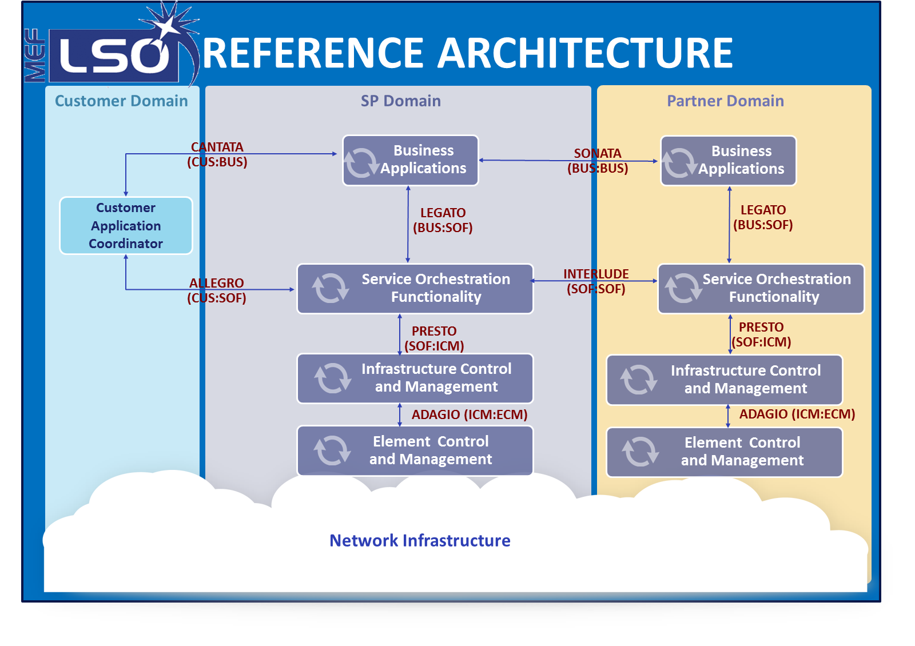
LSO Reference Architecture and Framework
Provides a layered architecture that characterizes the management and control domains and entities that enable the cooperative LSO capabilities for Connectivity Services.
High level operational threads describing user stories of orchestrated Connectivity Service behavior as well as interactions among management entities, expressing the vision of the MEF LSO capabilities
The management interface reference points that characterize interactions between LSO ecosystem components are identified in the reference architecture

Slide 4

Potential LSO Alignment to IETF –for discussion
Service Orchestration Functionality
Presto
MDSC
(IETF, ONF, other SDO based internal model)
Infrastructure Control and Management
IETF Model
Mediator
ONF Model
Mediator
ONF Model Transport API
Multi-model
Northbound Interface
IETF Models
ONF Models
Presto
MEF ExtSpec Models
PNC-A
PNC-B
PNC-C
Infrastructure Control and Management
Southbound Interface
(e.g. TL1, SNMP, CLI,
PCEP, NETCONF, etc.)
Network-A
Network-B
Network-C
Model Translation/Mediation: For multi-model environment, deployment use case must be fully supported by all models.
Model translation / mediation between systems using different models should be seamless.

Slide 5


CURRENT approach for MEF Projects
Sonata
CE Wholesale Serviceability
LSO RA Project
(MEF 55.0.y)
E
REFERENCE ARCHITECTURE
Sonata
CE Wholesale Ordering
Customer Domain
SP Domain
Partner Domain
Legato
CE Service Module (SCA Profile)
Cantata
(CUS:BUS)
Business Applications
Sonata
(BUS:BUS)
Business Applications
MEF Common Info Model
Customer
Application Coordinator
LEGATO
(BUS:SOF)
LEGATO
(BUS:SOF)
CE Info Model (MEF 7.3)
MEF Papyrus
Guidelines
MEF Modeling
Guidelines
6.2, 7.2, 10.3, 26.1, 28, 33, 45, 51, 54
Allegro
(CUS:SOF)
Service Orchestration Functionality
Interlude (SOF:SOF)
Service Orchestration Functionality
MEF Core Model Specification
Presto
(SOF:ICM)
Presto
(SOF:ICM)
Presto
Network Resource Provisioning (NRP Profile)
Infrastructure Control and Management
Infrastructure Control and Management
TMF GB922
ONF Core
ADAGIO (ICM:ECM)
ADAGIO (ICM:ECM)
Element Control and Management
Element Control and Management
Network Resource Model
Shared SDO Core Information
Model
ONF TAPI
Network Infrastructure

Slide 6
Leveraging T-API SDK Structure Considerations
Modularity
Package functional features into small self-contained largely-independent modules
Conformity
Standardize a single core technology-agnostic specification that abstracts all common transport network functions for the interface
Extensibility
Facilitate exchange of diverse network information specific to different layers, technologies, standards organizations and vendors in a consistent manner using the same API core model constructs
Interoperability
Ensure interoperability via conformance to the TAPI methodology and compliance with the core standardized TAPI spec

Slide 7
In progress discussion - MEF Modeling aligned with ONF
MEF Common - Interface Profiles
CANTATA/ALLEGRO EBI
C2B
PRESTO NBI
Infrastructure Control & Management
SONATA/INTERLUDE EBI
B2B
API IM relates to information exchanged over an interface and the entity definitions are intended to provide a logical structure for encapsulating information that is exchanged, and not intended to specify the information model patterns for implementations on either side of the interface
Network Resource Provisioning
LEGATO NBI
SOF
MEF Shared Information Context
Source: ONF TAPI SERVICES
Topology
Service
Connectivity
Service
Notification
Service
MEF Specifications
MEF Extension Specifications
Virtual Network
Service
Path Computation
Service
Import: TMF API
Import: ONF TAPI IM
MEF Core Model
Shared SDO Core Information
Model (ONF Core/TMF SID)
MEF Order Model
MEF Service Model
MEF Resource Model
Import: TMF GB922
Import: TMF GB922 & MEF10.3
Import: ONF Core

Slide 8
MEF 55 Entities
Management
Abstractions
Information Class Examples per Management Abstraction View
LSO RA
Context
CIM project focus is to model MEF 55 abstractions to support LSO management of Product, Service and Resource Views
CIM identifies relationship between leveraged TMF and ONF models
Model and Interface projects are based on CIM and share models that include attributes defined in MEF Technical Specifications
projects identify support for MEF 55 functional requirements
Resource View aligning with ONF TAPI model
Product View
Product Catalog
Product Offering
Customer
Product
Product Spec
Business Apps
Service Component
Service Access Point
Service Interface
Service Orchestration
(Provider domains & multi-domain)
Service View
Service
Service Spec
Service Orchestration & Infrastructure Management
(Subnetwork)
Resource View
Route
Fabric
Forwarding Domain
Forwarding Construct
Logical Termination Point
Network & Topology
Link
VNE
VNF
Card
Element Control & Management
Equipment
Network Element
Server
Rack
Chassis
Facility
Port
Notes:
Product View: The product domain is specific to the interaction between the Customer and the Product Offerings of a Service Provider.
Service View: A Product Instance is realized as one or more Services and associated Resources; thus Services are tightly bound to Product Instances and may be viewed to represent the Customer experience of the Product Instance that has been realized within the Service Provider’s infrastructure. <jcs> Since a Product is realized as Services AND Resources, both are “tightly bound”. But what does “tightly bound” mean? I am assuming that it acts similar to a composition, but I’m not sure.
In the SID and even ZOOM, Customer Experience is SEPARATE from Services and Resources. I think that this is a Good Thing. We’ve already corrected that in the CIM spec. </jcs>
Resource View Services are delivered via resources in the network, whether physical or logical. Physical resources are actual hardware, and logical resources can be viewed as functionality provided by specific pieces of hardware. The resource view can be further sub-divided into the Network and Topology View and the Element and Equipment View.
The Network and Topology View encompasses all the functions across network elements, on the basis of administrative network domains.
The Element and Equipment View pertains to the management of a specific set of devices.
<jcs> This is a long discussion. Briefly, PhysicalResource is broken if it subclasses from ManagedEntity – what is manageable about a Chassis? It is a hunk of metal. ☺ In Zoom, we subclassed PhyscialResource from UnManagedEntity. We do differentiate between LogicalResource and VirtualResource, and both are subclassed from Resource. The MEF CIM is being changed to reflect this. </jcs>

Slide 9
MEF 55 Entity Relationships
Management
Abstractions
Product Catalog
Product
Customer
Product
Spec
Product
Offering
Product View
Service
Service Access Point
Service
Interface
Service View
Service Spec
Service Component
Fabric
Forwarding Construct
VNF
Resource View
Forwarding Domain
Logical Termination Point
Network Function
Network & Topology
Link
Route
VNE
Rack
Element & Equipment
Chassis
Network Element
Card
Port
Server
TBD in MEF 55.x

Slide 10
Modeling Service to Network entities
MEF 55 Service View relationship to Network View
A Service is visible and directly usable by the Customer, but may be divided within the Service Provider's infrastructure into one or more Service Components, for instance corresponding to forwarding domains at the resource layer [Forwarding Construct is resource layer instance] or to underlying access services that the Service Provider has purchased from a Partner domain. Service Components are not visible to the Customer. Software systems implementing service related functionality have traditionally been operational support systems in the service management domain or service management systems. Note: in the TM Forum SID [TMF GB922], a Service is referred to as a Customer Facing Service (CFS) and a Service Component is referred to as a Resource Facing Service (RFS).
*Note -Although the UML from the TM Forum SID Model includes both the GB922 (classic SID objects) and the Zoom objects as independent models, the effort to align the GB922 with Zoom is outside the scope of MEF. Current approach is that MEF considers the GB922 objects for product and service constructs building a relationship to ONF constructs via a resource “placeholder” entity. MEF providing input and aligning with a shared SDO model.

Slide 11
Service View

Slide 12
Ethernet Service View Concepts
“ The ETH Layer is responsible for the service view presented by the Service Provider to its Subscribers and CENs participating in the Ethernet service. It is responsible for the instantiation of Ethernet MAC oriented connectivity services and the delivery of Ethernet service frames presented across well-defined internal and external interfaces and associated reference points”.
Ethernet Service An end-to-end connection (EVC) offered by a service provider between two or more subscriber sites (UNI’s)that enables the transfer of Ethernet Service Frames between them in accordance with a specified level of quality.
Ethernet Service Type A classification of an Ethernet service based upon the topology (i.e. p2p, mp2mp, rooted mp…) of the subscriber sites and a well specified direction of Ethernet flows between sites.
Ethernet Service Component A segment of an Ethernet service that represents connectivity (OVC) between a subscriber site and a network operator (UNI/ENNI), or connectivity between network operators (ENNI/ENNI), or connectivity between a service providers internal networks (UNI/INNI, INNI/INNI).
Ethernet Service Access Point An endpoint of an Ethernet service through which Ethernet service frames are classified, metered, and marked for transit through the Carrier Ethernet Network (EVC per UNI, OVC endpoint)
Ethernet Service Interface A place of interconnection between a subscriber site and an Ethernet service provider (UNI) , or between two service providers (ENNI). A demarcation point between administrative boundaries.
Ethernet Service Specification A specification of a set of Ethernet Service attributes and their associated values that characterize an Ethernet Service, an Ethernet Service Access Point, or an Ethernet Service Interface.

Slide 13

MEF Intra Provider Service Example
EVC
UNI
I-NNI
I-NNI
UNI
Aggregation
Network
Core
Network
Aggregation
Network
UNI (User-to-Network Interface)
Physical interface/demarcation between service provider and subscriber
Service start/end point
Ethernet Virtual Connection (EVC)
Logical representation of an Ethernet service as defined by the associate between 2 or more UNIs
NNI (Network-to-Network Interface)
Demarcation/peering point
between service provider internal networks (I-NNI)
between service provider networks (E-NNI) (not shown)

Slide 14
MEF 55 – Service View (SOF)
Service
Service Component
Service Component
Service Component
UNI
I-NNI
UNI
Aggregation
Network
I-NNI
Core
Network
Aggregation
Network
EVC

Slide 15
MEF Inter Provider Service Example
EVC
OVC
OVC
OVC
UNI
E-NNI
E-NNI
UNI
Operator 1
Network
Operator 2
Network
Operator 3
Network
UNI (User-to-Network Interface)
Physical interface/demarcation between service provider and subscriber
Service start/end point
Ethernet Virtual Connection (EVC)
Logical representation of an Ethernet service as defined by the association between 2 or more UNIs
Operator Virtual Connection (OVC)
Logical representation of an Ethernet service as defined by the association between 0 to many UNIs AND 1 or more ENNIs
NNI (Network-to-Network Interface)
Demarcation/peering point
between service provider internal networks (I-NNI) (not shown)
between service provider/operator networks (E-NNI)

Slide 16
MEF 55 – Service View (SOF)
Service
Service Component
Service Component
Service Component
UNI
E-NNI
E-NNI
UNI
Operator 1
Network
Operator 2
Network
Operator 3
Network

Slide 17
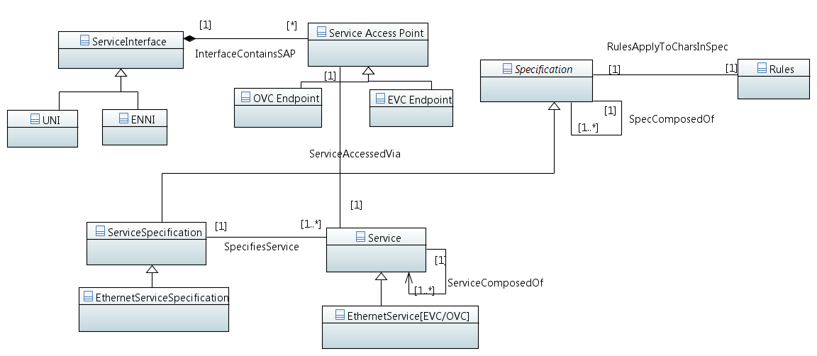
Service View MEF Core Model

Slide 18
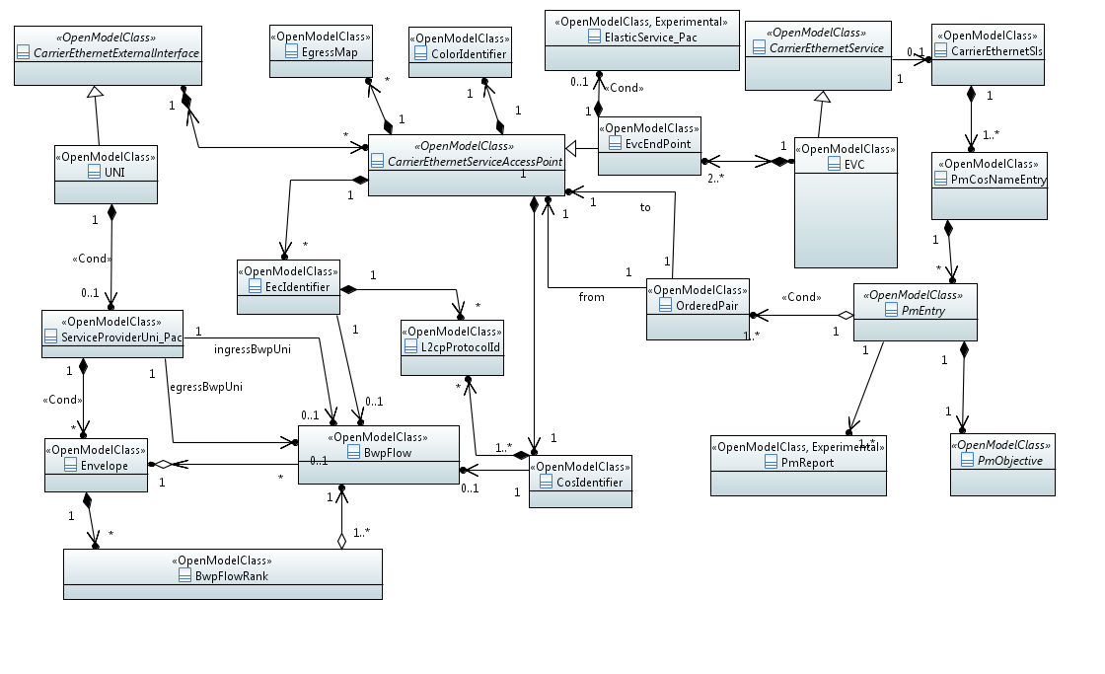
Proposed MEF 7.3 – Service Info Model

Slide 19
Resource View

Slide 20
Ethernet Resource View Concepts
“The ETH Layer is also responsible for all service-aware processing aspects associated with the treatment of the Service Frames, including operations, administration, maintenance and provisioning capabilities [of network resources] required in support of the Ethernet services”.
Ethernet Forwarding Domain A topological component of the Eth Layer defined by a set of Eth Service EndPoints, made available for the purpose of transferring information within a given administrative portion of the ETH layer network
Ethernet Link A topological component that describes a topological relationship between Ethernet Forwarding Domains.
Ethernet Forwarding Construct The ETH layer transport entity that conveys the ETH Characteristic information (CI) between a set of two or more ETH Layer termination points in a given ETH Layer.
Ethernet LTP Service EndPoint A reference point that represents a point of transfer for connectionless traffic units between Ethernet forwarding domains.
Ethernet LTP Node EndPoint A reference point that represents a point of entry into an Ethernet Layer Network.

Slide 21
MEF 55 - Network View (SOF)
VPLS Pool
Forwarding Domain
Forwarding Construct
type=transit
Link
Link
Id Pool
VLAN Pool
Forwarding Domain
Forwarding Domain
Logical Termination Point
type=INNI
Logical Termination Point
type=INNI
Forwarding Construct
type=edge
Forwarding Construct
type=edge
Logical Termination Point
type=UNI
Logical Termination Point
type=INNI
Logical Termination Point
type=INNI
Logical Termination Point
type=UNI
UNI
I-NNI
UNI
Aggregation
Network
I-NNI
Core
Network
Aggregation
Network
EVC

Slide 22
Network View (ICM)
VPLS Pool
Forwarding Domain
Connectivity Service (FC)
type=transit
Link
Link
Id Pool
VLAN Pool
Forwarding Domain
LPSpec = Eth
type=INNI
LPSpec = Eth
type=INNI
Forwarding Domain
Connectivity Service (FC)
type=edge
ServiceEndPoint (LTP)
ServiceEndPoint (LTP)
Connectivity Service (FC)
type=edge
NodeEdgePoint (LTP)
NodeEdgePoint (LTP)
LPSpec = Eth
type=UNI
LPSpec = Eth
type=INNI
LPSpec = Eth
type=INNI
LPSpec = Eth
type=UNI
ServiceEndPoint (LTP)
ServiceEndPoint (LTP)
ServiceEndPoint (LTP)
ServiceEndPoint (LTP)
NodeEdgePoint (LTP)
NodeEdgePoint (LTP)
NodeEdgePoint (LTP)
NodeEdgePoint (LTP)
UNI
I-NNI
UNI
Aggregation
Network
I-NNI
Core
Network
Aggregation
Network
EVC

Slide 23
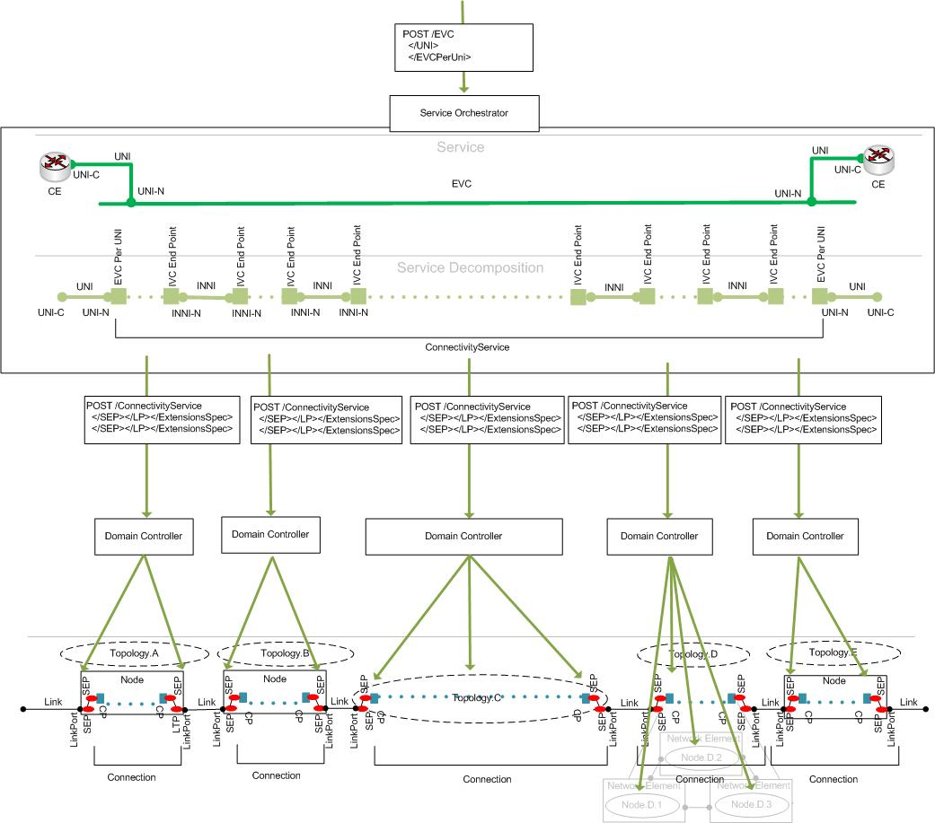
MEF PRESTO NRP View
PRESTO

Slide 24
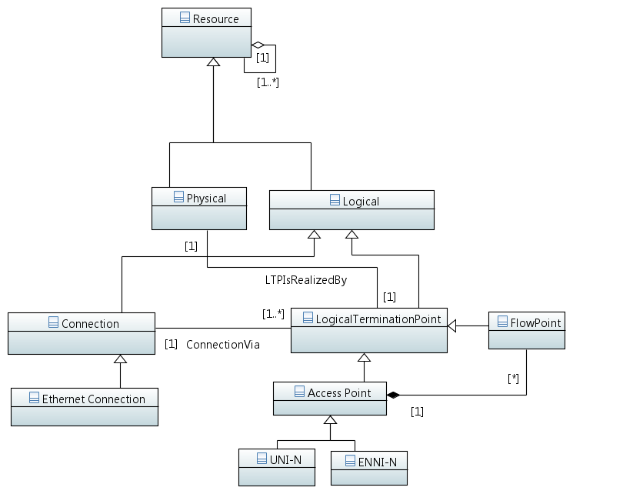
Network View MEF Core Model
Forwarding Construct
Service EndPoint
Forwarding Construct
Node EndPoint

Slide 25
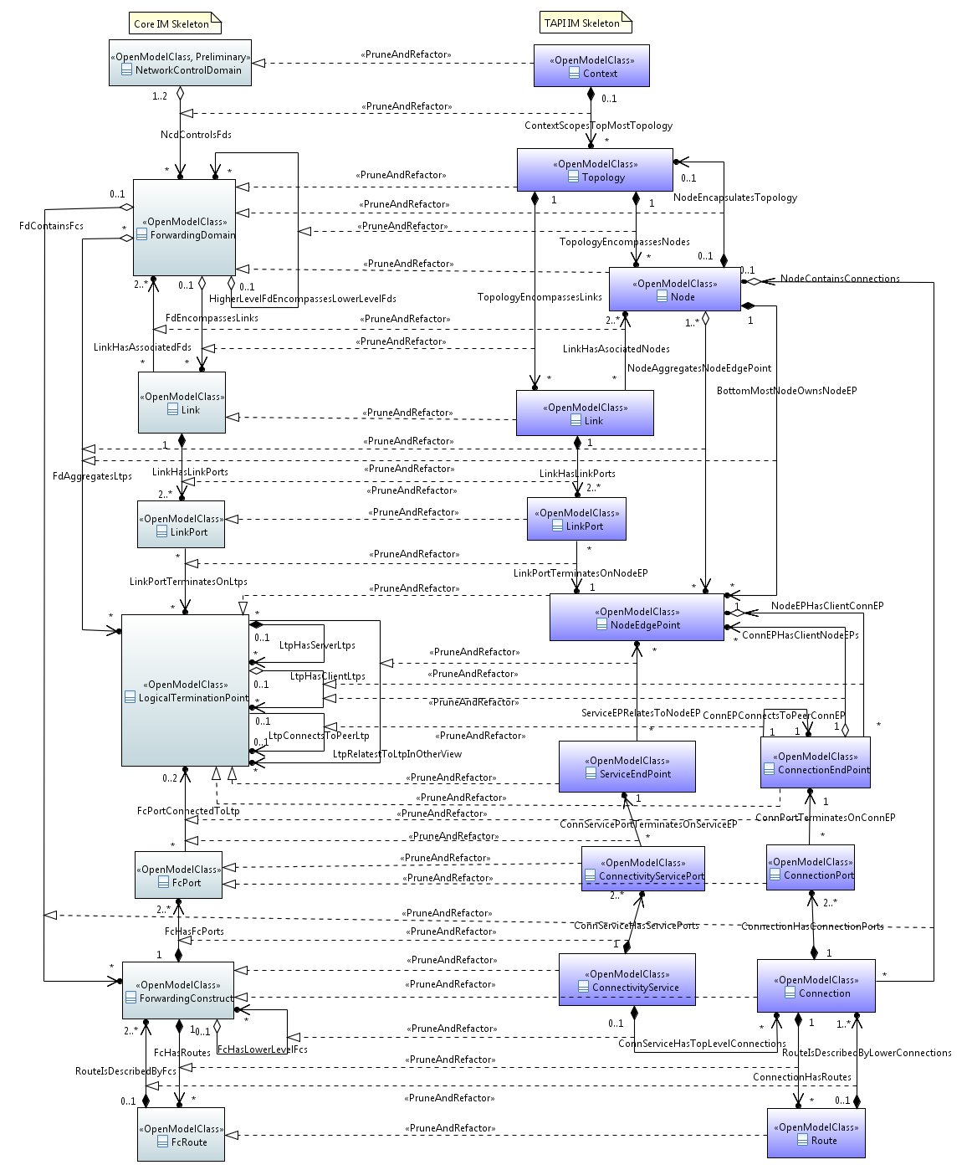
ONF CORE with ONF TAPI realization

Slide 26
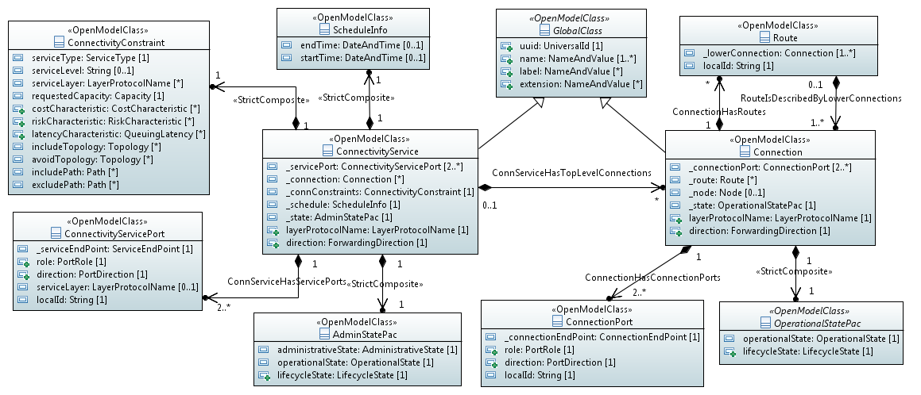
ONF TAPI – Connectivity Model

Slide 27
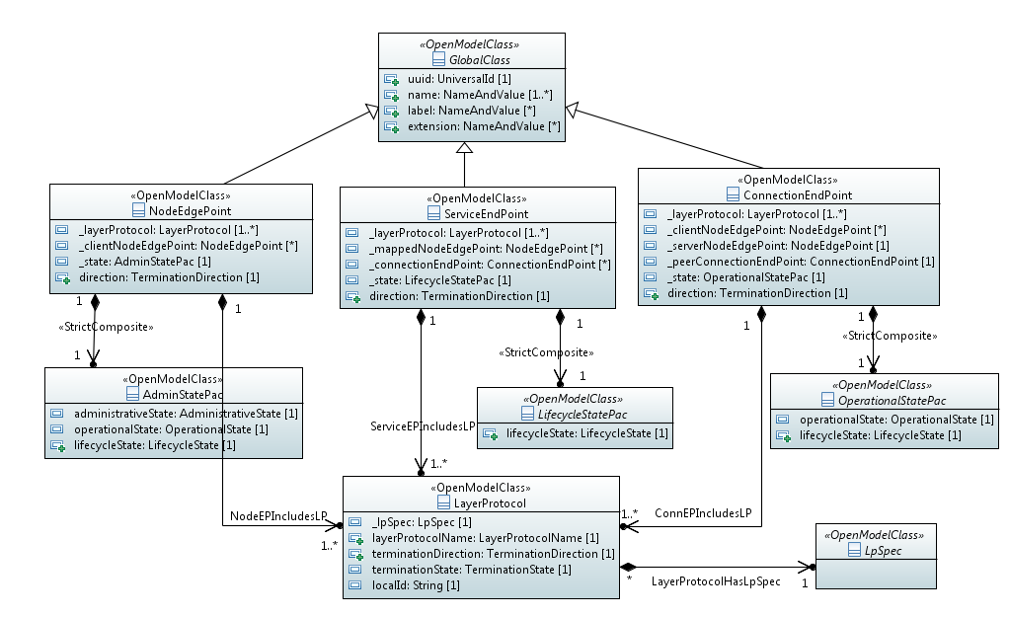
ONF TAPI – Endpoint Model

Slide 28
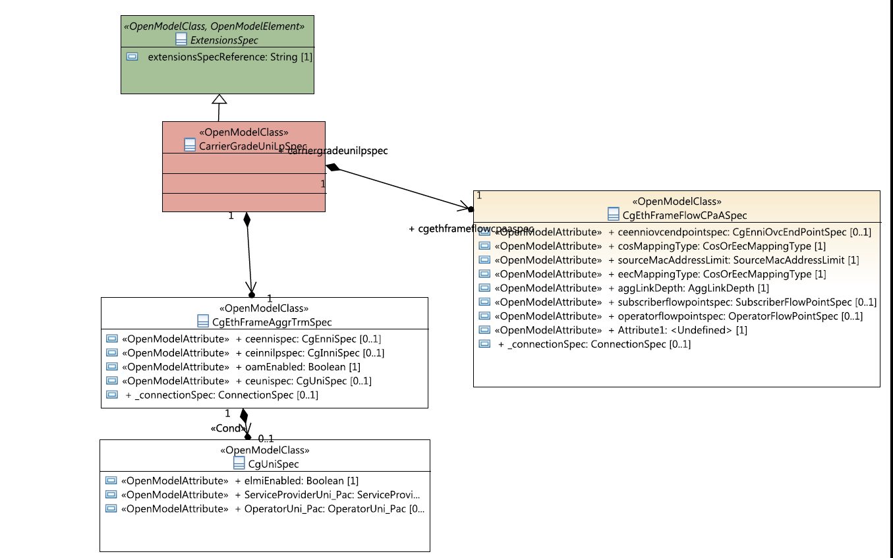
MEF NRP/NRM – Network Model based on TAPI

